Slide 1
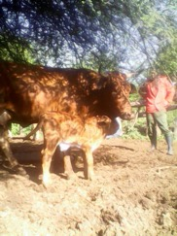
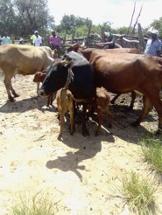
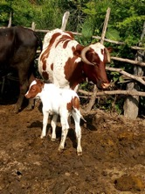
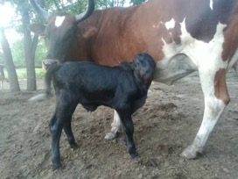
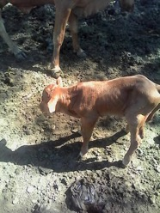
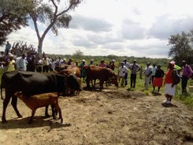
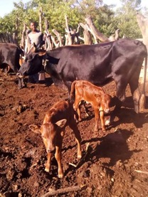
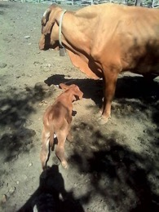
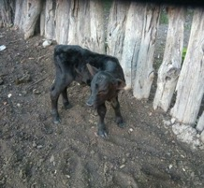
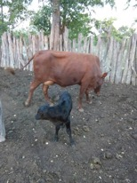
ZRBF Project - Some of the Calves Born

Slide 2
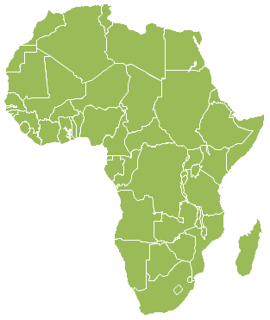
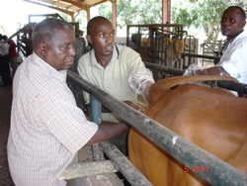
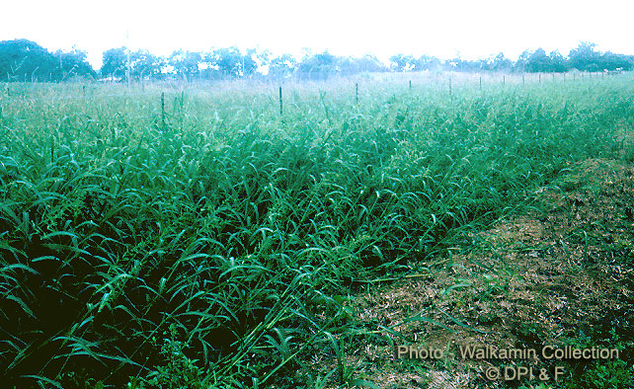
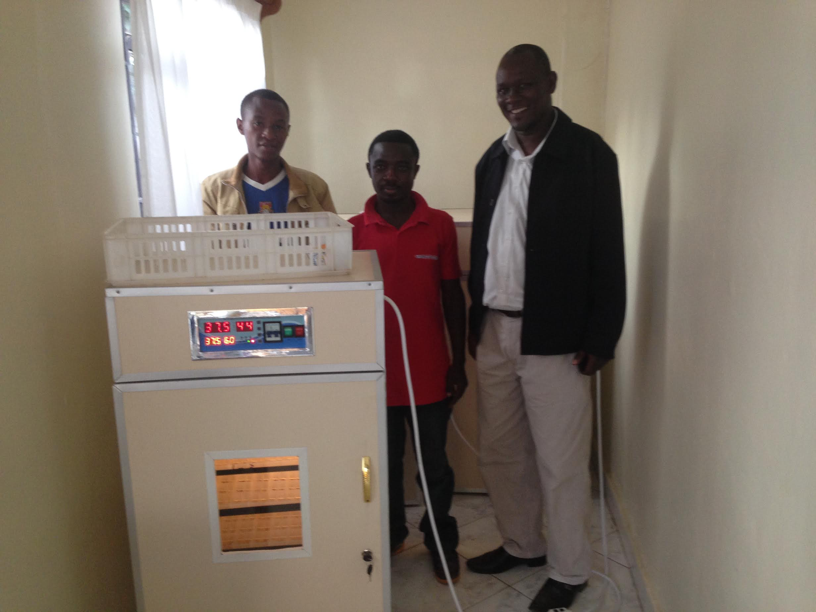
ABS TCM Ltd
Livestock Development
USAID, BMGF, DFID, DANIDA
LOL, HPI, TNS, ILRI, ICRAF, SNV
Key
Services
Cattle & Goat Breeding
Artificial Insemination
1
Livestock Feeds & Feeding
3
2
Indigenous Poultry Artificial Brooding

Slide 3
ABS TCM Activities
Key
Services
1
3
Cattle & Goat Breeding
Artificial Insemination
Livestock Feeds & Feeding
2
Indigenous Poultry Artificial Brooding

Slide 4
ABS TCM (Pvt) Ltd Activities
Fattening Pens & Handling Facilities
Poultry Brooding house & Goat Pens
Breed Improvement - AI
Fodder Storage & Pulverizing

Slide 5
ZRBF Project - Some of the Calves Born

Slide 6
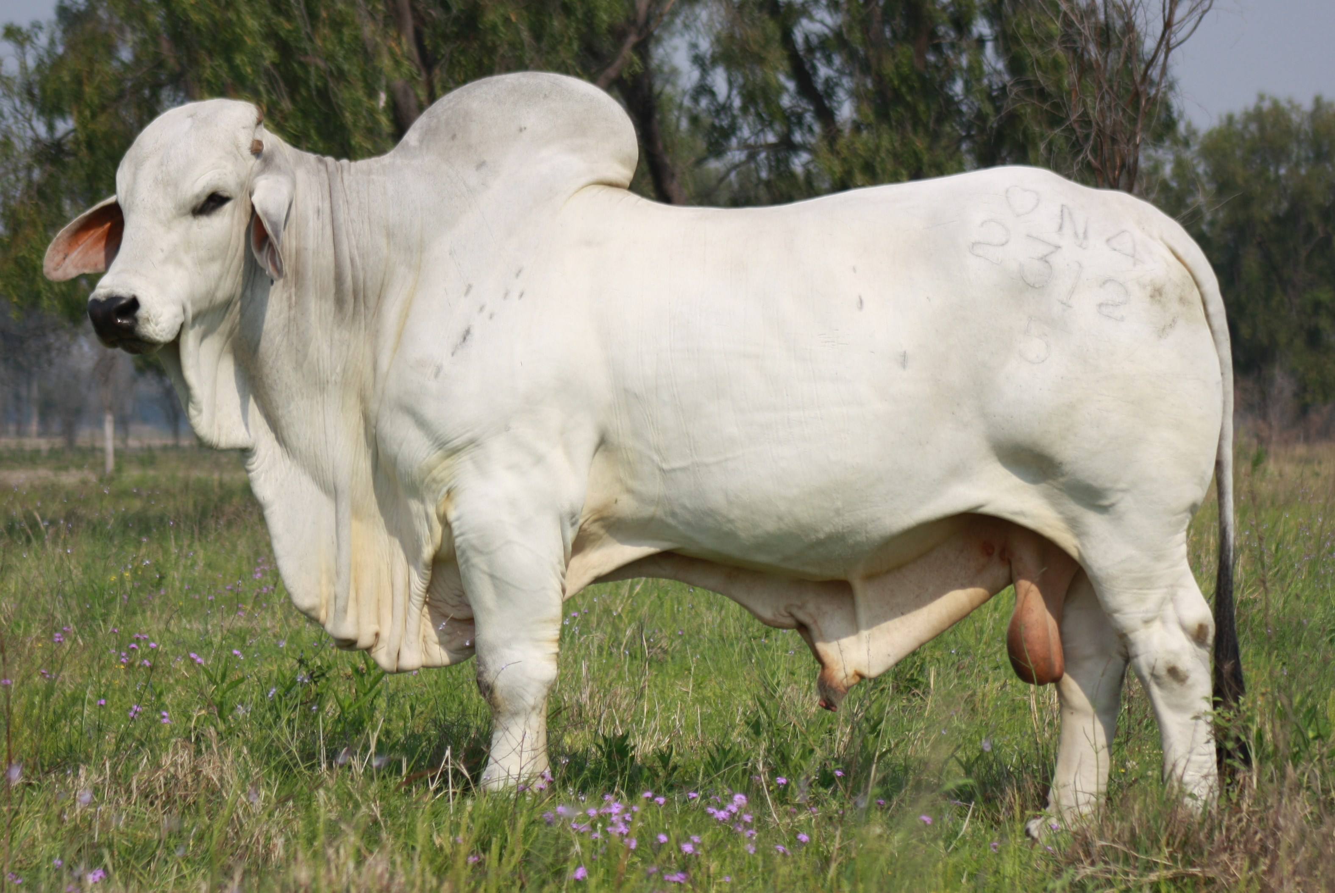
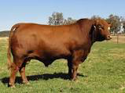
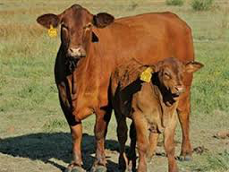
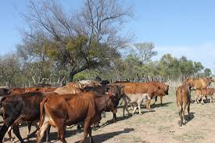
Cattle AI & Income outcome
900 kg
Item | Before | After
AI Cost | 5 | 65
Feed | 438 | 480
Labour | 504 | 252
Revenue | 604 | 1,292
Income/steer | -343 | 495
587 kg
275 kg

Slide 7
Artificial brooding indigenous Poultry
Item | Before | After
Cost of day old chick | 0.1 | 0.1
Eggs laid | 4.8 | 14.4
Spent hen & males | 10 | 10
Gross Revenue | 14.9 | 24.5

